Slide 1
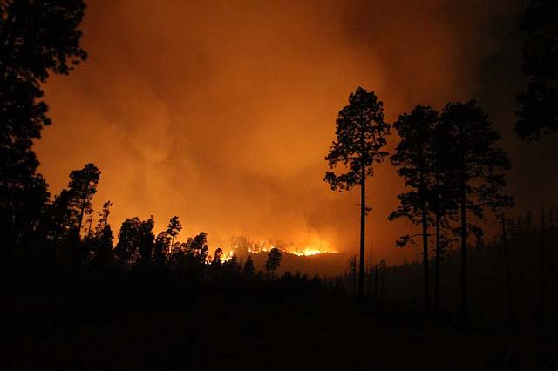


Wildland Fire Preparedness
Emergency Management
Local Emergency Planning Committee
March 2025

Slide 2
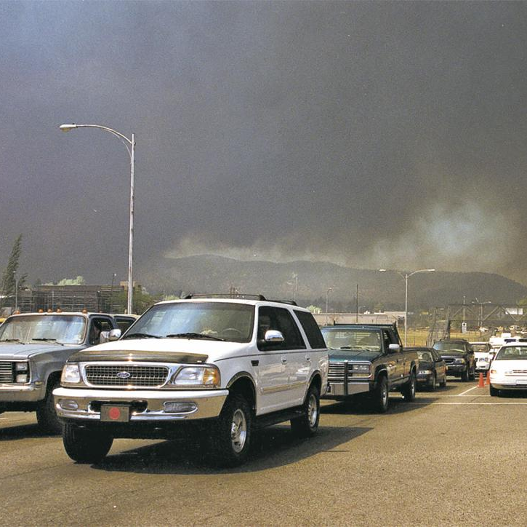
Agenda
Understanding the Risk
Community Wildfire Protection Plan
Seasonal Outlook
Ready, Set, Go!
Defensible Space
What is Defensible Space?
Zones of Defensible Space
Defensible Home Assessments
Code Red Emergency Alerts
Family Communication Plan
Questions

Slide 3
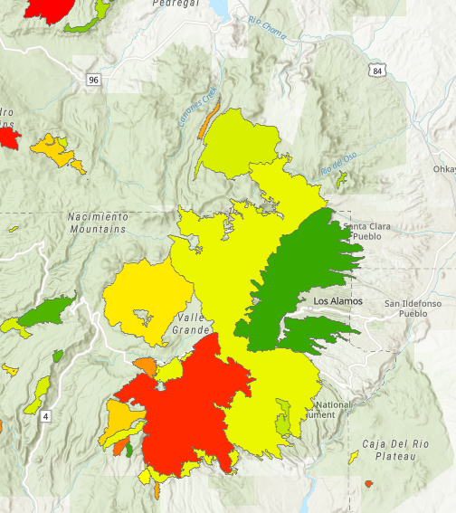
Understanding the Risk
2011 Las Conchas Fire
2000 Cerro Grande Fire
2000 Cerro Grande Fire: 43,000 acres
2011 Las Conchas Fire: 148,000 acres
2013 Thompson Ridge Fire: 23,968 acres
2022 Cerro Pelado Fire: 45, 604 acres
CWPP Overview and Results
2013 Thompson Ridge Fire
2022 Cerro Pelado Fire

Slide 4
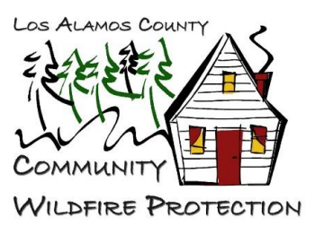
Community Wildfire Protection Plan (CWPP)
The CWPP was updated in 2022.
The plan analyzes the wildland fire risk to Los Alamos County.
The plan informs wildland fire mitigation through science-based risk analysis to target areas identified as high risk.
The National Hazard and Risk Model (No-HARM) was the decision support tool for the wildfire hazard and risk assessment.
The tool incorporates the predicted severity (hazard) and the predicted frequency (risk) of wildfire in each location. (Results indicated each Fire Shed analyzed in analysis ranged from high to very high)

Slide 5
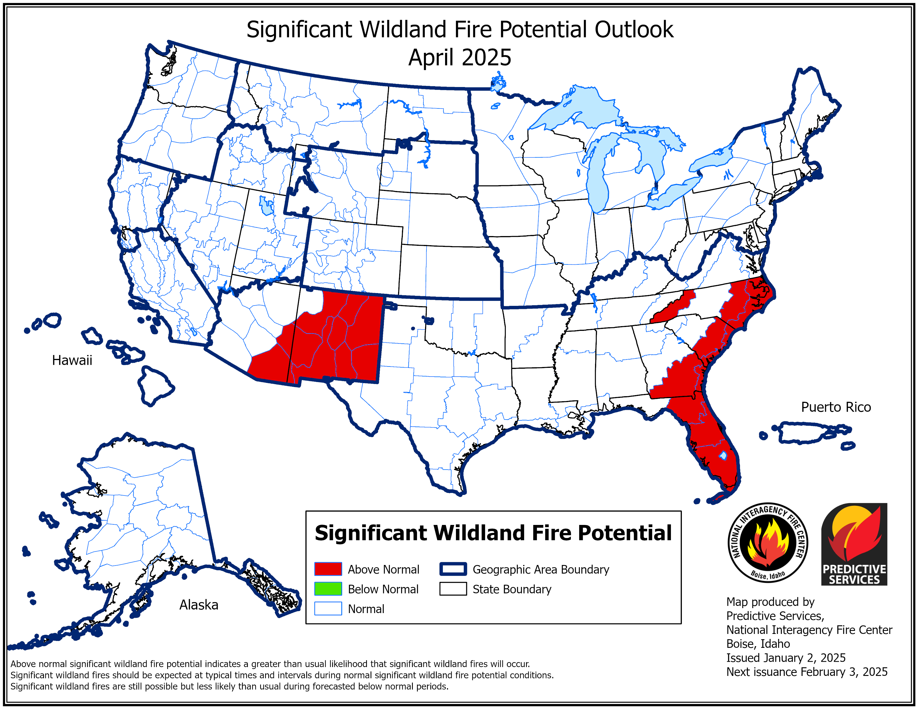
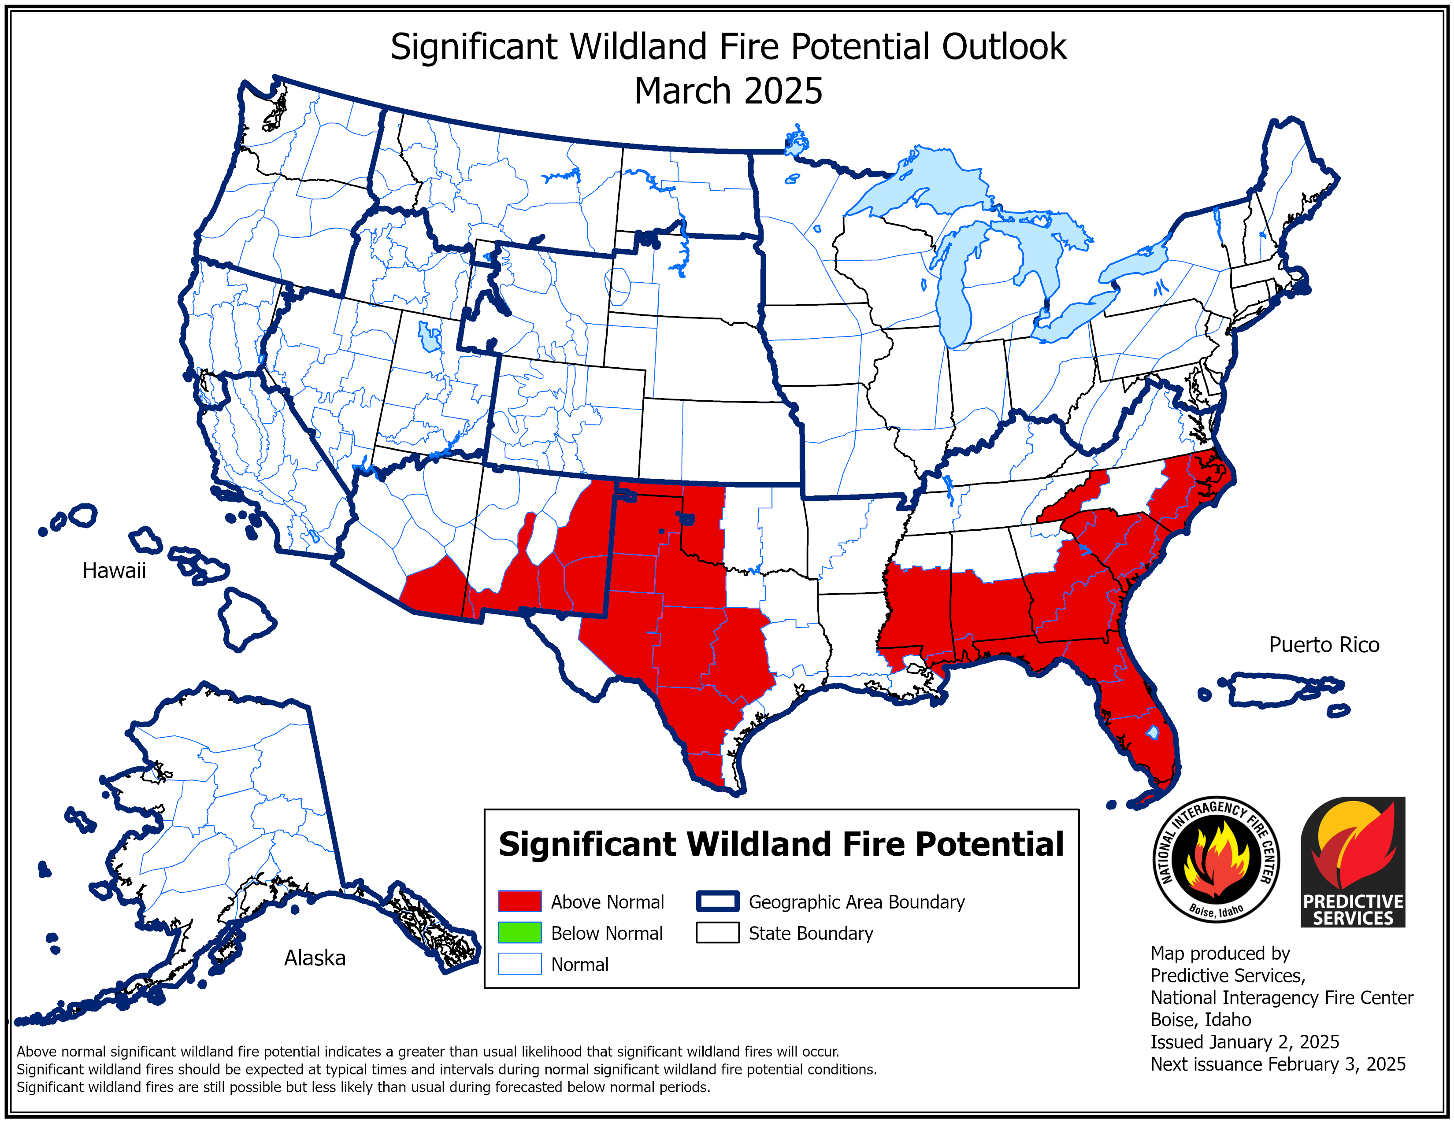
Seasonal Outlook
Significant fire potential will be normal to above normal across the Southwest Area through April.
Periods of critical winds combined with low humidity conditions are expected by late winter into the early spring focused along and east of New Mexico’s central mountains

Slide 6

Ready, Set, Go!
Ready | Prepare your home and property: Create defensible space around your home Clear leaves, branches, and debris from gutters, roofs, and decks. Use fire-resistant building materials. Have an emergency kit with essentials. Know your evacuation routes and have a plan in place
Set | Stay Informed: Monitor local news, alerts, and weather conditions. Use apps and services for fire-related updates. Create a communication plan: Share your evacuation plan with family members. Have a safe meeting place if separated
Go | Evacuate early: If you are told to evacuate, do not wait until the last minute. Follow evacuation routes, avoiding areas with heavy smoke or fire activity. Take your emergency kit and valuables while prioritizing safety.

Slide 7
What is Defensible Space?
A defensible space is a buffer zone between a structure and the surrounding wildland area, designed to reduce the risk of fire spreading to the building.
It allows firefighters to protect homes and properties in the event of a wildfire

Slide 8
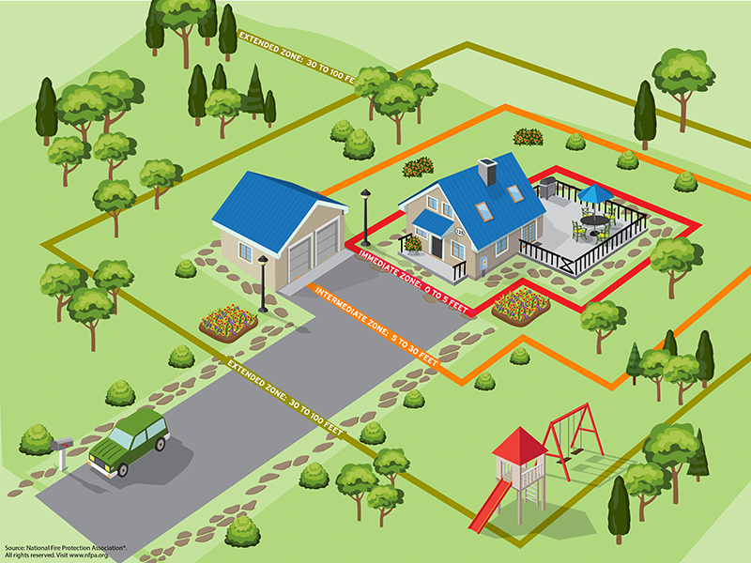
Zones of Defensible Space
Zone 1: Immediate Zone (0-5 feet from structure)
Keep all flammable materials away from the home (e.g., wood piles, mulch, etc.).
Use fire-resistant plants and hardscaping.
Clear roof and gutters of debris
Zone 2: Intermediate Zone (5-30 feet from structure)
Maintain a defensible zone by thinning vegetation.
Space trees and shrubs to reduce fire spread.
Remove dead and dry vegetation and leaves.
Zone 3: Extened Zone (30-100 feet or more from structure)
Create a natural buffer to slow fire spread.
Remove excess dead or dry vegetation and trees.
Maintain space between trees to prevent fire from jumping from one to another

Slide 9
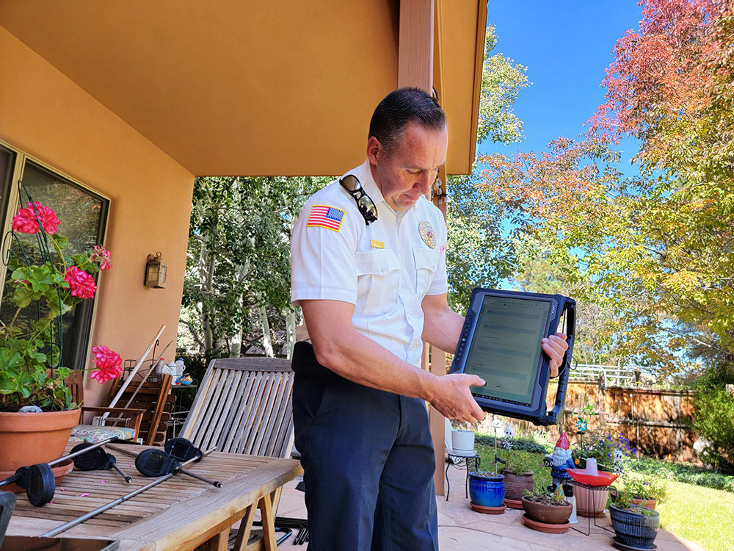
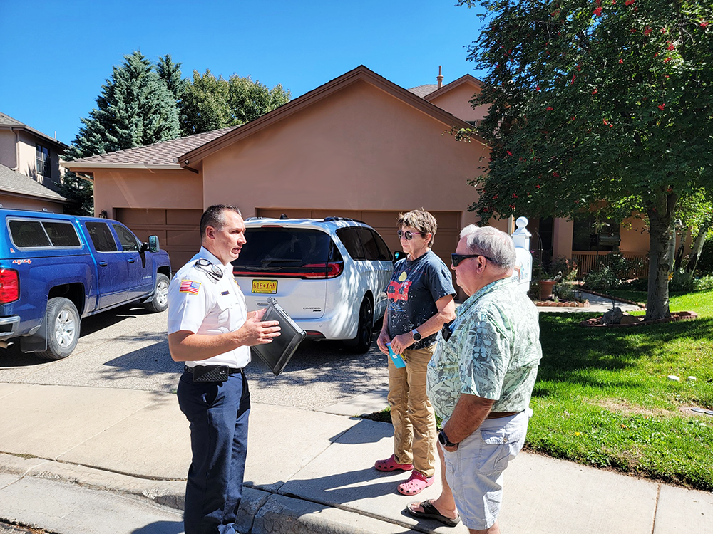
Defensible Space Home Assessments
LAFD has launched an onsite wildfire assessment program free of charge to home and business owners.
LAFD has conducted more than 500 wildfire assessments to date throughout the community.
To schedule a free wildland fire home or business assessment in Los Alamos or White Rock, email kelly.sterna@lacnm.us.
Please visit the Wildland Division website for more resources and information: https://www.losalamosnm.us/Health-and-Public-Safety/Fire-Services/Wildland-Division

Slide 10

Emergency Alerts
Sign Up for Alerts: Register yourself and family members for timely emergency notifications.
Fast & Direct Communication: The system automatically sends alerts to registered devices.
Recognize Alerts: Calls come from 866-419-5000 (Emergency Notification). Save this number for easy recognition.
Stay Informed: Receive important updates during emergencies directly from county officials
Sign up at: Community Notification Enrollment
Text “losalamos” to 99411 to sign up for CodeRED emergency alerts

Slide 11


Family Emergency Plan
Create a Family Communication Plan
Contact Information: List out family members' phone numbers, emails, and work/school addresses.
Out-of-Area Contact: Designate a friend or relative to be the central point of contact in case family members are separated.
Plan for Communication: Decide how to communicate if phone lines or cell service is down (e.g., text messages, social media, etc.).
Establish Meeting Locations
Near Home: Identify a safe, easily accessible place to meet if you must evacuate (e.g., a neighbor’s house or mailbox).
Outside of Town: Choose a location outside your immediate area in case of a widespread emergency or evacuation.
Prepare an Emergency Kit
Essentials: Pack food, water, first aid, medications, flashlight, extra batteries, important documents, and personal items.
Pet Supplies: Include food, water, and pet medications if applicable.
Practice the Plan
Drills: Regularly practice evacuations and communication to ensure everyone knows what to do during an emergency.

Slide 12
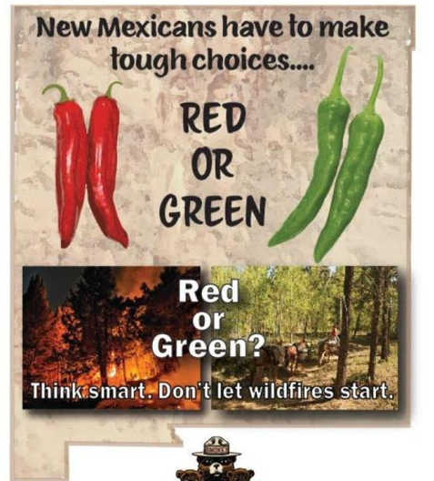
Questions?
Visit the Los Alamos County’s Office of Emergency Management for resources discussed in this presentation:
https://www.losalamosnm.us/Health-and-Public-Safety/Emergency-Management
Email: LACOEM@lacnm.us

