Slide 1
Climate Action Plan and Greenhouse Gas Inventories Overview
County Council Meeting | August 22, 2023
Notes:
Andrea

Slide 2



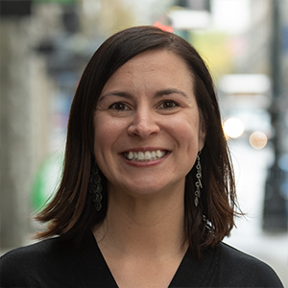




Project Team
County
Cascadia Consulting Group
AMM
EcoDataLab
Angelica Gurule
Sustainability Manager
Linda Matteson
Deputy County Manager
Abbey Hayward
Conservation Coordinator
Andrea Martin
Project Manager
Alicia Fennel
Deputy Project Manager
Jenna Decker
GHG Emissions & Strategy Analyst
Amy Miller
Outreach & Engagement Lead
Ben Gould
Consumption-Based Inventory Lead
Notes:
Andrea
Introduce project team

Slide 3
Meeting Goals
Provide background and an overview of the Climate Action Plan (CAP) development process.
Provide background and an overview of the Outreach Plan, including future County Council touchpoints.
Provide background and an overview of the greenhouse gas (GHG) inventories’ methodology.
Notes:
Andrea
Our goals today are to
Provide County Council with background information on what a Climate Action Plan is, an overview of the development process, and our scope on this project.
Provide a background and overview of the Outreach Plan which will inform the engagement process of the CAP, including future County Council touchpoints, as well as public engagement touchpoints
Provide a background and overview of the greenhouse gas inventories’ methodology
We’ll be leaving time at the end to answer any questions on the project as well as to gather any initial feedback you’d like to share.

Slide 4
Climate Action Plan Overview
Notes:
Andrea

Slide 5
What is a CAP?
A CAP will provide a strategic framework that will offer a suite of actions aimed to reduce greenhouse gas (GHG) emissions and identify opportunities to increase climate resilience, such as enhancing resource conservation and preparing for impacts like extreme heat, within the community.
Focus areas within a CAP typically include:
  Mobility/Transportation & Land Use
  Buildings & Energy
  Waste & Materials Management
  Natural Systems & Water
  Community Resilience
Notes:
Andrea
What is covered under with of these focus areas?
Mobility/Transportation & Land Use: Reduce greenhouse gas emissions through clean and efficient transportation and equipment.
Buildings & Energy: Increase renewable energy use and energy efficiency in buildings and facilities.
Waste & Materials Management: Improve sustainable consumption and reduce waste.
Natural Resources & Water: Support climate-resilient natural landscapes, store more carbon, and ensure sustainable water use.
Community Resilience: Build resilience to climate change impacts, improve community wellbeing.

Slide 6
CAP Development – Project Scope
Develop an Outreach Plan that will be used to inform engagement throughout the CAP process
Complete GHG inventories for communitywide and County operations emissions
Complete a future emissions forecast
Complete a cost-benefit analysis
Identify preliminary goals and metrics within each focus area
Identify and prioritize strategies and actions
Draft and finalize the CAP
Notes:
Andrea
Develop an Outreach Plan (ongoing implementation throughout the process): The Outreach Plan outlines the engagement goals, key audiences, roles, approaches, and timelines.
Complete GHG inventories for communitywide and County Operations: The communitywide GHG inventories include a geographic and consumption-based inventory. The geographic inventory quantifies emissions occurring within the County’s geographic boundaries from activities like transportation, energy consumption, and waste generation. The consumption-based GHG inventory will capture all emissions occurring from County residents’ purchased goods, services, and travel. The County operations GHG inventory will quantify GHG emissions occurring from the County government, such as County fleet and County-operated utilities.
Complete a future emissions forecast: While GHG inventories provide a current snapshot of the County’s emissions, the wedge analysis illustrates how emissions are projected to change into the future. This analysis helps to inform a pathway to carbon neutrality.
Complete a cost-benefit analysis: The cost-benefit analysis will analyze the costs and benefits of a number of strategies and actions to ensure that the strategies and actions prioritized for CAP inclusion represent the actions with the best return on investment. Making the greatest emissions reduction impacts, with the lowest cost to the County and residents. This cost-benefit analysis also includes the cost of inaction.
Identify preliminary goals and metrics within each focus area: Using the GHG Inventories, wedge analysis, and the cost-benefit analysis we will identify concrete, sector-specific goals and metrics for achieving the County’s overarching climate and sustainability goals.
Identify and prioritize strategies and actions: Identify the most promising carbon reduction pathways and adaptation measures, tailored for Los Alamos County based on the GHG inventory and wedge analysis, engagement, and a quantitative cost-benefit analysis of CAP strategies and actions.
Draft and finalize the CAP: Develop a final Climate Action Plan and implementation strategy.
Pause for questions.

Slide 7
CAP Timeline
June 2024
Oct 2023
Dec 2023
Finalize strategies and actions
Present draft CAP
Baseline policy assessment
Finalize GHG inventories
Finalize forecasting analysis
April 2024
CAP goals and targets set
Present draft actions for budgeting considerations
Aug 2023
Present Outreach Plan & GHG methodology
Oct 2024
Finalize CAP & present for adoption
Finalize Implementation Plan
PUBLIC & STAKEHOLDER ENGAGEMENT
Council touchpoint
Notes:
Andrea
The proposed timeline illustrates a high-level overview of what to expect from today, till the final CAP is presented for proposed approval.

Slide 8
Outreach Plan
Notes:
Jenna

Slide 9
What is an Outreach Plan?
An Outreach Plan will inform who, how, and when we plan to engage members of the public, internal County staff, and external County stakeholders
The Outreach Plan helps to ensure that the final CAP reflects Los Alamos County’s priorities
Notes:
Jenna
An Outreach Plan will inform who, how, and when we plan to engage members of the public, internal County staff, and external County stakeholders throughout the planning process
The Outreach Plan helps to ensure that members of the community and County are engaged throughout the process so that the final CAP is implementable and reflects Los Alamos County’s community priorities

Slide 10
Levels of Engagement
Inform | Consult | Involve | Collaborate
Educate members of the group about the rationale for the project or decision; how it fits with County goals and policies; issues being considered, areas of choice or where input is needed. | Gather information and ask for feedback from group to better inform the County’s work on the project. | Work directly and consistently with group to ensure their concerns are understood and considered in the County’s planning process. | Create a partnership to work along with the County in developing and implementing the planning process or project.
Activities
Social media Emails/newsletters Presentations Factsheets Council/Board meetings Meetings with staff and email updates | Online community survey Online public feedback platform Focus groups/ interviews Interactive posterboards Pop-up events Council/Board meetings | Interactive community workshops Focus groups/ interviews Council/Board meetings | Regular stakeholder group meetings
Notes:
Jenna
There is a spectrum of community engagement that allocates different levels of power to the community and uses different activity types:
At the inform level we’ll be focusing on education about the project, how it fits with County goals and policies, the issues the project will consider, and outline when we’ll be reaching out for community and stakeholder input. We’ll accomplish this through social media, emails and newsletters, presentations, factsheets, having discussions like these at Council, Board, and staff meetings.
During consult level we plan to gather information and feedback from the community and stakeholders to better understand and reflect community priorities. We plan to accomplish this through an online survey and public feedback platform (like Konveio for draft CAP, online comment box on the County’s website, etc.), focus groups and interviews, pop-up events with interactive posterboards, and having discussions at Council and Board meetings.
At the third level, involve, we plan to work directly and consistently with the community and stakeholder groups to ensure concerns are understood and considered in the County’s planning process by hosting interactive community workshops, hosting additional focus groups and interviews, and having discussions at Council and Board meetings.
During the final level, collaborate, we plan to create a working partnership to develop the implementation plan through regular stakeholder group meetings for implementation and beyond.
(Potential focus groups / interviews: County staff/implementation leads, specific community group / leaders to represent their community groups, etc.)
(Stakeholder groups: Community-based group, County staff implementation lead group)

Slide 11
Phases of Engagement
Phase 1: Raising Profile and Visioning
Phase 2: Collaborative Planning
Phase 3: Refinement & Implementation Transition
Notes:
Jenna
The Outreach Plan proposes 3 phases of engagement throughout the planning process:
Raising profile and visioning, where we currently are
Collaborative planning
Refinement and implementation transition

Slide 12

Phase 1: Raising Profile and Visioning
Public Engagement
Community survey & in-person surveying at events
Internal Stakeholder Engagement
County Council meeting to introduce project & methods
Focus groups
Interviews
As-needed staff meetings
Focus group with County staff
Notes:
Jenna
In the first phase of engagement we’ll be building early awareness of the CAP, gathering ideas, priorities, and concerns, gaining baseline context, and building stakeholder relationships.
We’ll gather community ideas, priorities, and concerns through a public survey, participate in in-person surveying at events, and host focus groups and interviews to obtain targeted feedback.
This first phase includes today’s meeting with you all to introduce the project and GHG methodologies, and we’ll also be hosting a County staff focus group.

Slide 13
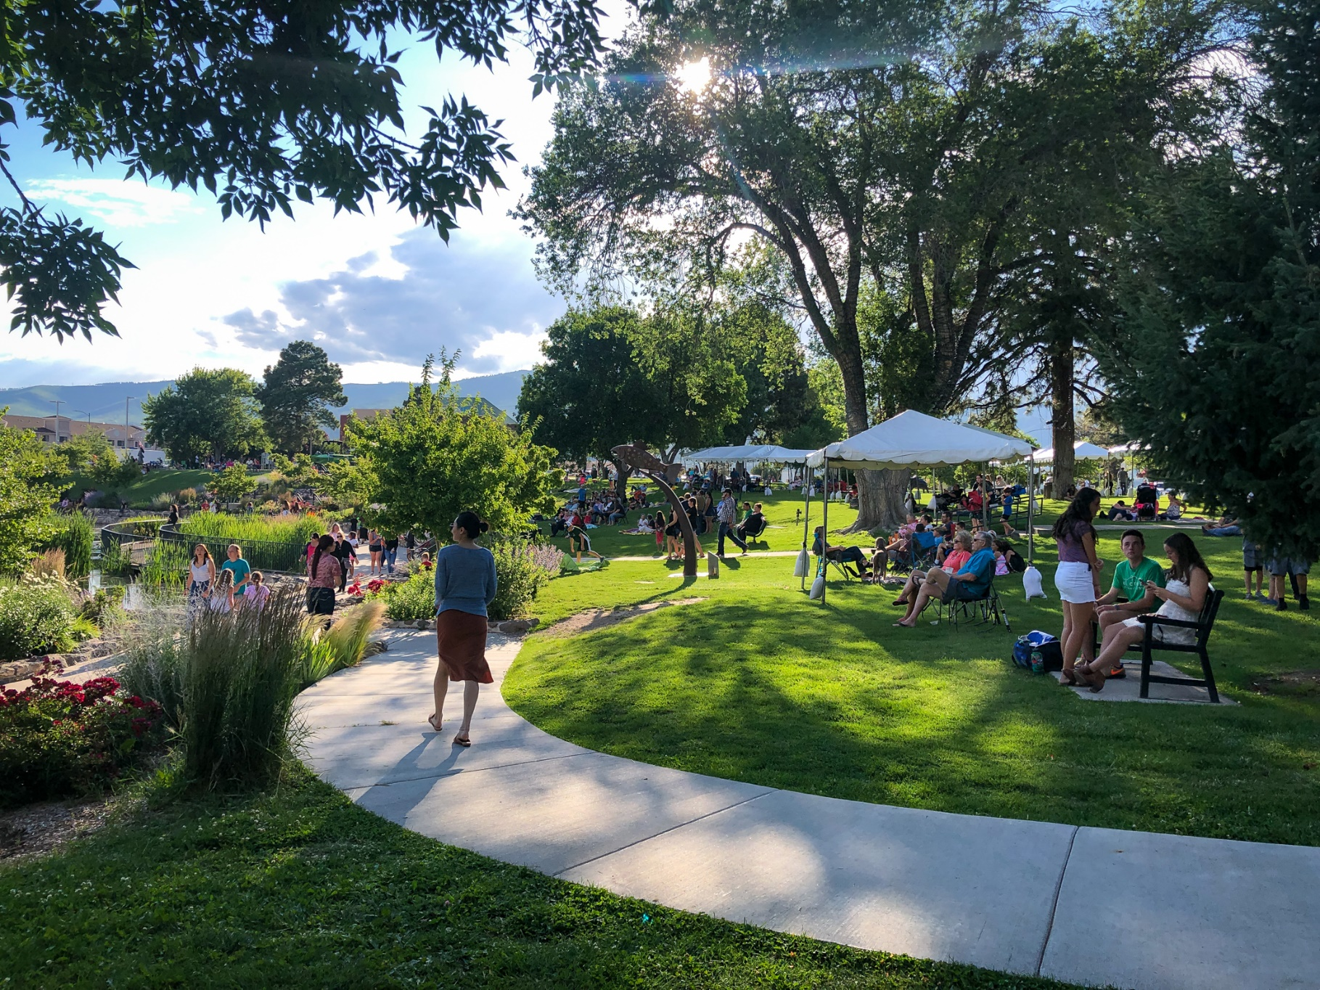
Phase 2: Collaborative Planning
Public Engagement
Public community workshop
Internal Stakeholder Engagement
County Council meeting to present GHG results & high-level actions
As-needed staff meetings
ESB/stakeholder meeting
Notes:
Jenna
In the second phase of engagement we’ll focus on Collaborative planning to vet and prioritize proposed targets, goals, strategies, and actions for inclusion in the CAP.
Once draft strategies and actions have been developed based on phase 1 feedback we’ll bring them to the public through a public community workshop. We’ll also be bringing GHG results and high-level actions to this group at a future Council meeting, as well as to a stakeholder meeting that includes representatives from ESB (environmental sustainability board), LARES (pronounced lah- rez), BPU (board of public utilities), and other stakeholder groups. Additionally, we’ll continue collaborating with County staff as needed. Each of these engagement approaches will help to refine our list of strategies and actions for CAP inclusion and will help to ensure the final product is representative of Los Alamos’ unique priorities.

Slide 14
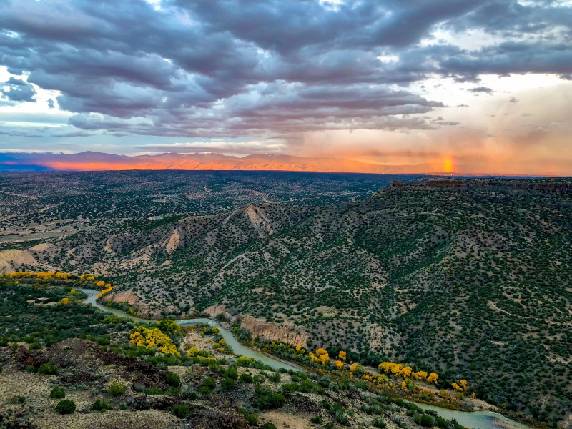
Phase 3: Refinement & Implementation Transition
Public Engagement
Online public feedback platform for draft CAP
Internal Stakeholder Engagement
County Council meetings:
Circulate draft CAP to staff for comment
Present draft CAP
Present CAP for adoption
Notes:
Jenna
In the third phase of engagement we’ll be refining the draft CAP and transitioning to Implementation planning. We’ll take the feedback we heard in the second phase of engagement to draft a CAP that will be open for public comment through an online platform. This CAP will also be circulated among County staff for comment. We’ll then be presenting that draft CAP to Council to hear any additional feedback before presenting the final CAP for adoption.

Slide 15
GHG Inventories
Notes:
Jenna

Slide 16
Introduction to GHG Inventories
Geographic Communitywide
Quantifies the emissions occurring within the County’s geographic bounds from residents and visitors from activities such as transportation, heating and cooling buildings, solid waste disposal, and wastewater treatment.
Consumption-Based (CBEI)
Quantifies the upstream emissions occurring anywhere in the world from County resident purchased goods, services, and travel.
County Operations
Quantifies the emissions occurring from County operations including County fleet, energy consumption, solid waste disposal, wastewater treatment, and any County-operated utilities.
Notes:
Jenna
We’ll be completing 3 different types of inventories. A geographic communitywide, a consumption-based, and a County operations inventory.
The geographic communitywide inventory will quantify the emissions that occur within the County’s geographic bounds. This includes emissions from residents and visitors from various activities including transportation, heating and cooling of buildings, solid waste disposal, and wastewater treatment.
The consumption-based emissions inventory will quantify the upstream emissions that occur from County residents’ purchased goods, services, and travel from anywhere in the world.
The County operations inventory emissions are considered part of the community emissions, not in addition to avoid double counting. This inventory will quantify the emissions occurring from the County’s operations including County fleet, energy consumption, solid waste disposal, wastewater treatment, and County-operated utilities.

Slide 17
GHG Inventories Methodology
Protocols
Data Collection & Analysis
Geographic Communitywide
  U.S. Community Protocol (USCP)
CBEI
  EcoDataLab/CoolClimate approach
County Operations
  Local Government Operations Protocol (LGOP)
  Uses a combination of available real-world consumption data with predictions based upon demographic, regional, and national averages
  Community & County Operations
    Inventory year: 2022
    Inventory platform: ClearPath
  CBEI
    Inventory years: 2007-2021
Notes:
Jenna
We perform our inventories following best-practice methods and protocols.
The Geographic communitywide inventory utilizes the U.S. Community Protocol for Accounting and Reporting of GHG emissions.
The Consumption-Based emissions inventory uses a combination of the EcoDataLab and CoolClimate approach to develop their models. (This model is a custom-built econometric (e-con-a-metric) modeling approach that models consumer behavior based on household demographics and local geography).
The County operations inventory follows the Local Government Operations Protocol for the Quantification and Reporting of GHG emissions.
All inventories use a combination of available real-world consumption data with predictions based on demographic, regional, and national averages.
We’ll be completing the geographic community wide and County Operations inventories for the year of 2022.
The CBEI will be performed for the range of 2007-2021
The inventories will be completed using the Local Governments for Sustainability, also know as ICLEI’s ClearPath platform, which is a nationally recognized tool for streamlining community and governmental GHG inventories.

Slide 18
Geographic Communitywide Emissions Sources & Methodology
Emissions Source | Methodology
Building energy (electricity & natural gas) | Consumption data from utilities multiplied by regional emissions factor
Transportation (on-road & public transit) | Combining vehicle miles traveled data from NMDOT & ICLEI vehicle & fuel-specific emissions factors Transit gallons consumed by vehicle & fuel type multiplied by vehicle and fuel-specific emissions factors
Solid waste (generation & transportation to landfill) | Tonnage, landfill, & transportation data from Public Works multiplied by EPA WARM emissions factors
Wastewater (treatment process) | Facility-specific consumption & treatment processes multiplied by treatment-specific emissions factors
Notes:
Jenna
Building energy (electricity & natural gas): We collect consumption data from utilities and apply the regional emissions factor to estimate emissions.
Transportation (on-road & public transit): We collect vehicle miles traveled in Los Alamos County from NMDOT’s transportation model then apply ICLEI vehicle and fuel-specific emissions factors. For transit we take transit gallons consumed by vehicle and fuel type and apply the vehicle fuel-specific emissions factor.
Solid waste (generation & transportation to landfill): We collect tonnage, landfill and waste characteristics, and transportation to landfill data from the Public Works department then apply the EPA Waste Reduction Model’s (WARM) emissions factors.
Wastewater (treatment process): We collect facility-specific consumption data and treatment process specifics then follow the protocol’s equation using the treatment-specific emissions factors.

Slide 19
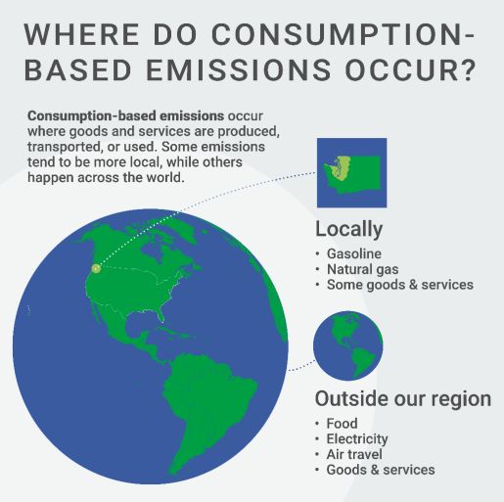
Consumption-Based Emissions Sources
  Household transportation (driving, air travel)
  Household energy use
  Household food consumption
  Household purchased goods (furnishings, electronics, apparel, etc.)
  Household purchased services (healthcare, entertainment, education, etc.)
  Home construction & maintenance
Notes:
Jenna
The consumption-based inventory will report emissions from:
Household transportation (driving, air travel)
Household energy use
Household food consumption
Household purchased goods (furnishings, electronics, apparel, etc.)
Household purchased services (healthcare, entertainment, education, etc.)
Home construction & maintenance
Image source: Puget Sound Regional Emissions Analysis

Slide 20





Consumption-Based Methodology
      Modeling approach based on local household characteristics
      Incorporating local consumption data & emission factors where available – household energy, water, transportation
Notes:
Jenna
The consumption-based inventory will calculate and report those emissions by:
Using EcoDataLab’s custom modeling approach based on local household characteristics and
Incorporating local consumption data & emission factors where available – household energy, water, transportation. Where local data is not available, national, state, and regional averages will be assumed based on local demographics.

Slide 21
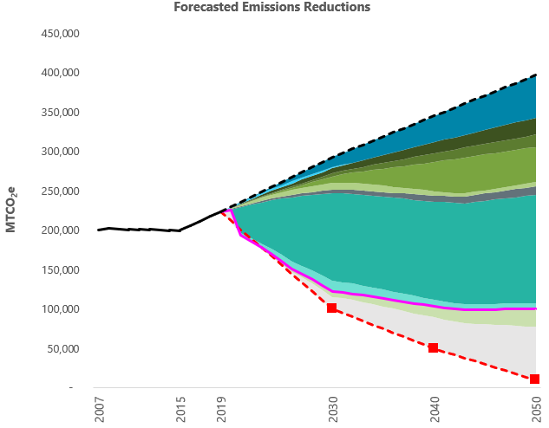
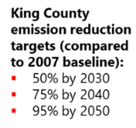
GHG Wedge Forecast
Business-as-usual (no action future)
  Assumes no action is taken to reduce emissions
Adjusted business-as-usual (policy scenario)
  Assumes no action is taken to reduce emissions beyond implementing federal, state, and regional policies
Emissions gap (additional local action)
  Where can Los Alamos County reduce future emissions?
Example:
Notes:
Jenna
Once the GHG inventories have been completed we’ll be taking the results a step further to model emissions out to 2050 through 3 different scenarios. We’ve provided an example of a wedge we completed for King County in Washington to help visualize what we’ll be doing for Los Alamos County once the results for the GHG inventories are finalized. The scenarios modeled are the:
The business-as-usual scenario, (dotted black line) which models a no action future. This scenario assumes that no action has been taken from any entity to reduce emissions.
The adjusted-business-as-usual, (neon pink line) which models federal, state, and regional policies that are in place to reduce emissions but no other action.
The emissions gap, (dotted red line) which considers additional local action that can be taken in Los Alamos County to close the gap from the adjusted-business-as-usual scenario to reach carbon neutrality by 2050. (additional local action levers can be pulled to see how that action reduces local emisisons)

Slide 22
CAP Next Steps
June 2024
Oct 2023
Dec 2023
Finalize strategies and actions
Present draft CAP
Baseline policy assessment
Finalize GHG inventories
Finalize forecasting analysis
April 2024
CAP goals and targets set
Present draft actions for budgeting considerations
Aug 2023
Present Outreach Plan & GHG methodology
Oct 2024
Finalize CAP & present for adoption
Finalize Implementation Plan
PUBLIC & STAKEHOLDER ENGAGEMENT
Council touchpoint
Notes:
Jenna
So where do we go from here? Today we’ve presented the proposed CAP planning process, the Outreach Plan, and the GHG methodologies. We are currently kicking off the first phase of engagement and finishing up GHG data collection. Next, we’ll start the baseline policy assessment to ensure CAP actions are unique and relevant to Los Alamos County, launch a public survey, and get to work on calculating emissions from the collected data. Our next planned touchpoint with you all we will be presenting select draft CAP strategies and actions for feedback and budgeting considerations.

Slide 23
Thank you!
Questions?
Contact Information:
Andrea Martin: Andream@CascadiaConsulting.com
Alicia Fennell: Alicia@CascadiaConsulting.com
Notes:
Jenna

